Slide 1
Introduction to statistics
Mean
Median
Mode
Standard Deviation & Variance
Population Mean & Sample Mean

Slide 2
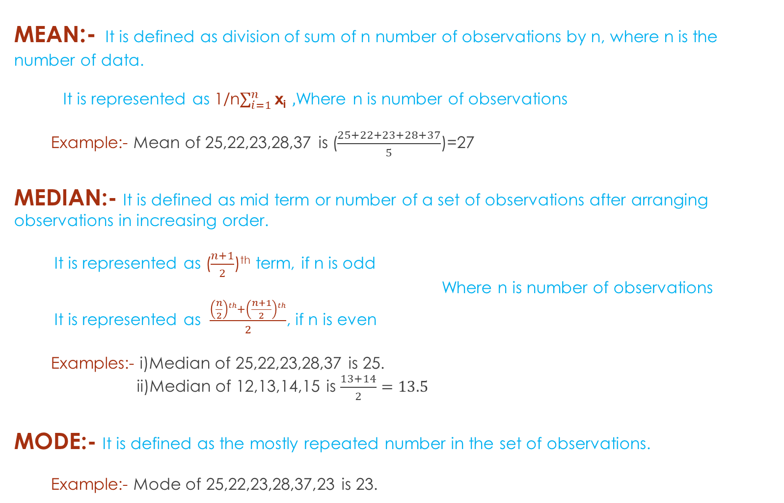
MEAN:- It is defined as division of sum of n number of observations by n, where n is the number of data. It is represented as 1/n$\sum_{i=1}^{n}{\text{x}\text{i}} ,$Where n is number of observations Example:- Mean of 25,22,23,28,37 is ($\frac{25+22+23+28+37}{5}$)=27 MEDIAN:- It is defined as mid term or number of a set of observations after arranging observations in increasing order. It is represented as ($\frac{n+1}{2}$)^{th} term, if n is odd Where n is number of observations It is represented as $\frac{\left(\frac{n}{2}\right)th+\left(\frac{n+1}{2}\right)th}{2}$, if n is even Examples:- i)Median of 25,22,23,28,37 is 25. ii)Median of 12,13,14,15 is $\frac{13+14}{2}=13.5$ MODE:- It is defined as the mostly repeated number in the set of observations. Example:- Mode of 25,22,23,28,37,23 is 23.

Slide 3
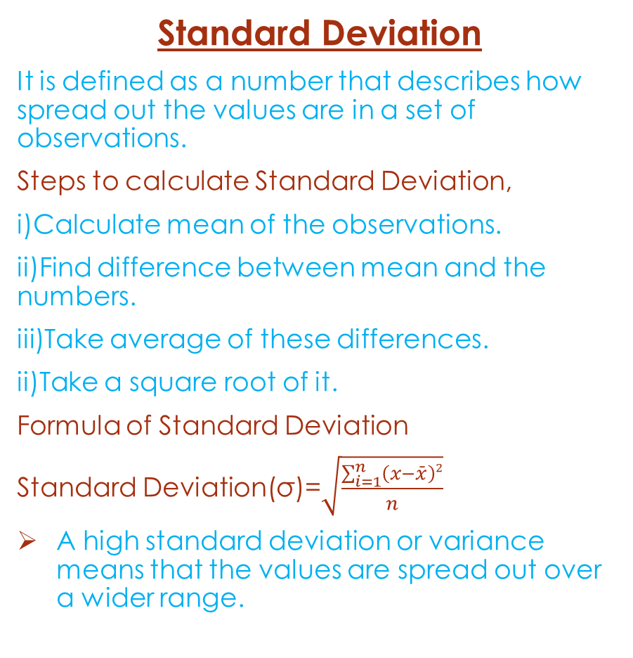
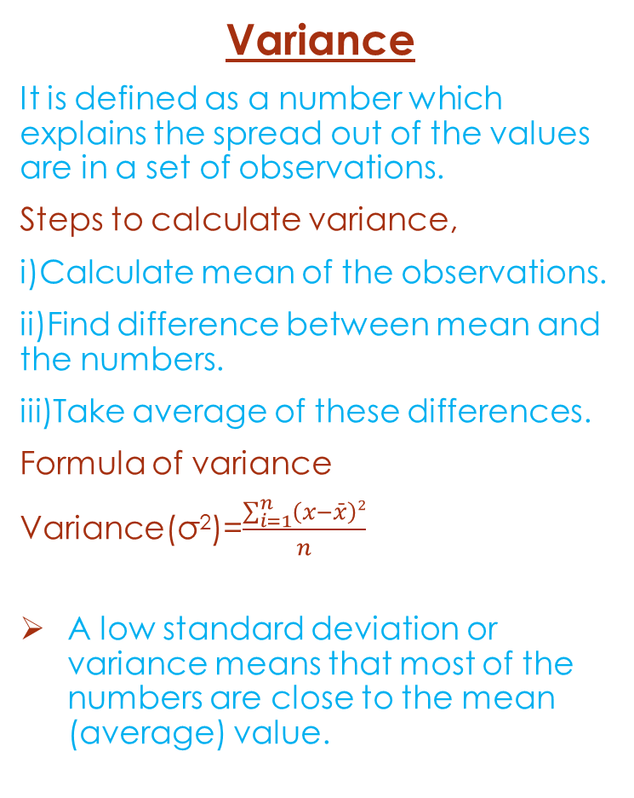
Variance
It is defined as a number which explains the spread out of the values are in a set of observations.
Steps to calculate variance,
i)Calculate mean of the observations.
ii)Find difference between mean and the numbers.
iii)Take average of these differences.
Formula of variance
Variance(σ²)=$\frac{\sum_{i=1}^{n}{\left(x−\bar{x}\right)2}}{n}$
A low standard deviation or variance means that most of the numbers are close to the mean (average) value.
Standard Deviation
It is defined as a number that describes how spread out the values are in a set of observations.
Steps to calculate Standard Deviation,
i)Calculate mean of the observations.
ii)Find difference between mean and the numbers.
iii)Take average of these differences.
ii)Take a square root of it.
Formula of Standard Deviation
Standard Deviation(σ)=$\sqrt{\frac{\sum_{i=1}^{n}{\left(x−\bar{x}\right)2}}{n}}$
A high standard deviation or variance means that the values are spread out over a wider range.

Slide 4
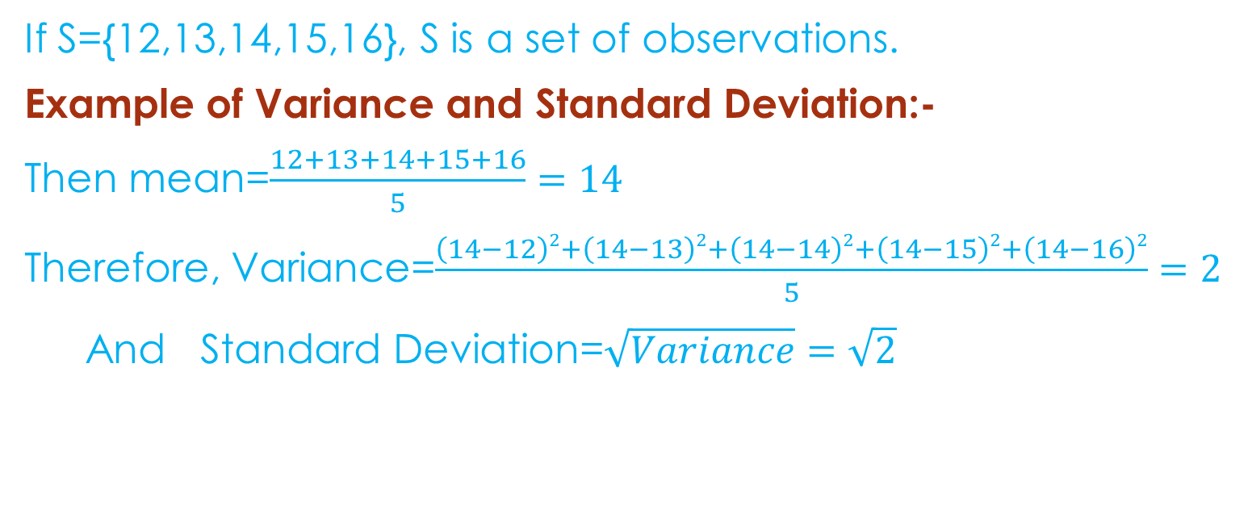
If S={12,13,14,15,16}, S is a set of observations.
Example of Variance and Standard Deviation:-
Then mean=$\frac{12+13+14+15+16}{5}=14$
Therefore, Variance=$\frac{\left(14−12\right)2+\left(14−13\right)2+\left(14−14\right)2+\left(14−15\right)2+\left(14−16\right)2}{5}=2$
And Standard Deviation=$\sqrt{Variance}=\sqrt{2}$

Slide 5
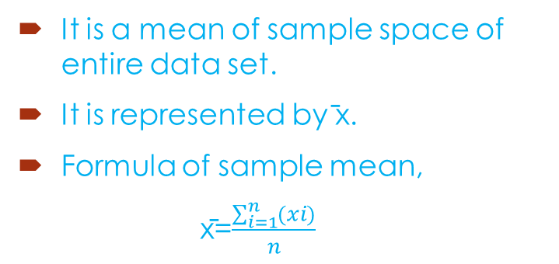
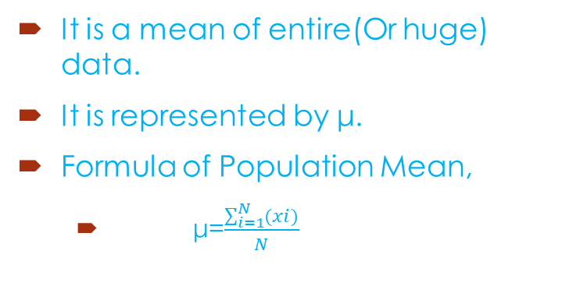
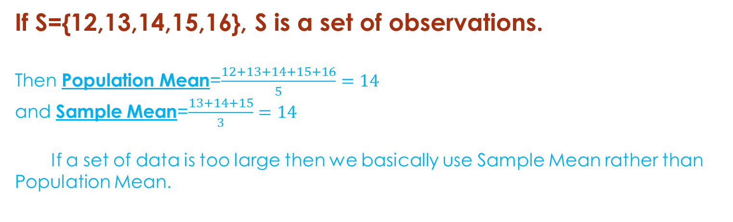
If S={12,13,14,15,16}, S is a set of observations. Then Population Mean=$\frac{12+13+14+15+16}{5}=14$ and Sample Mean=$\frac{13+14+15}{3}=14$ If a set of data is too large then we basically use Sample Mean rather than Population Mean.
POPULAION MEAN
SAMPLE MEAN
It is a mean of entire(Or huge) data.
It is represented by μ.
Formula of Population Mean,
μ=$\frac{\sum_{i=1}^{N}{(xi)}}{N}$
It is a mean of sample space of entire data set.
It is represented by ̄x.
Formula of sample mean,
x̄=$\frac{\sum_{i=1}^{n}{(xi)}}{n}$

Slide 6
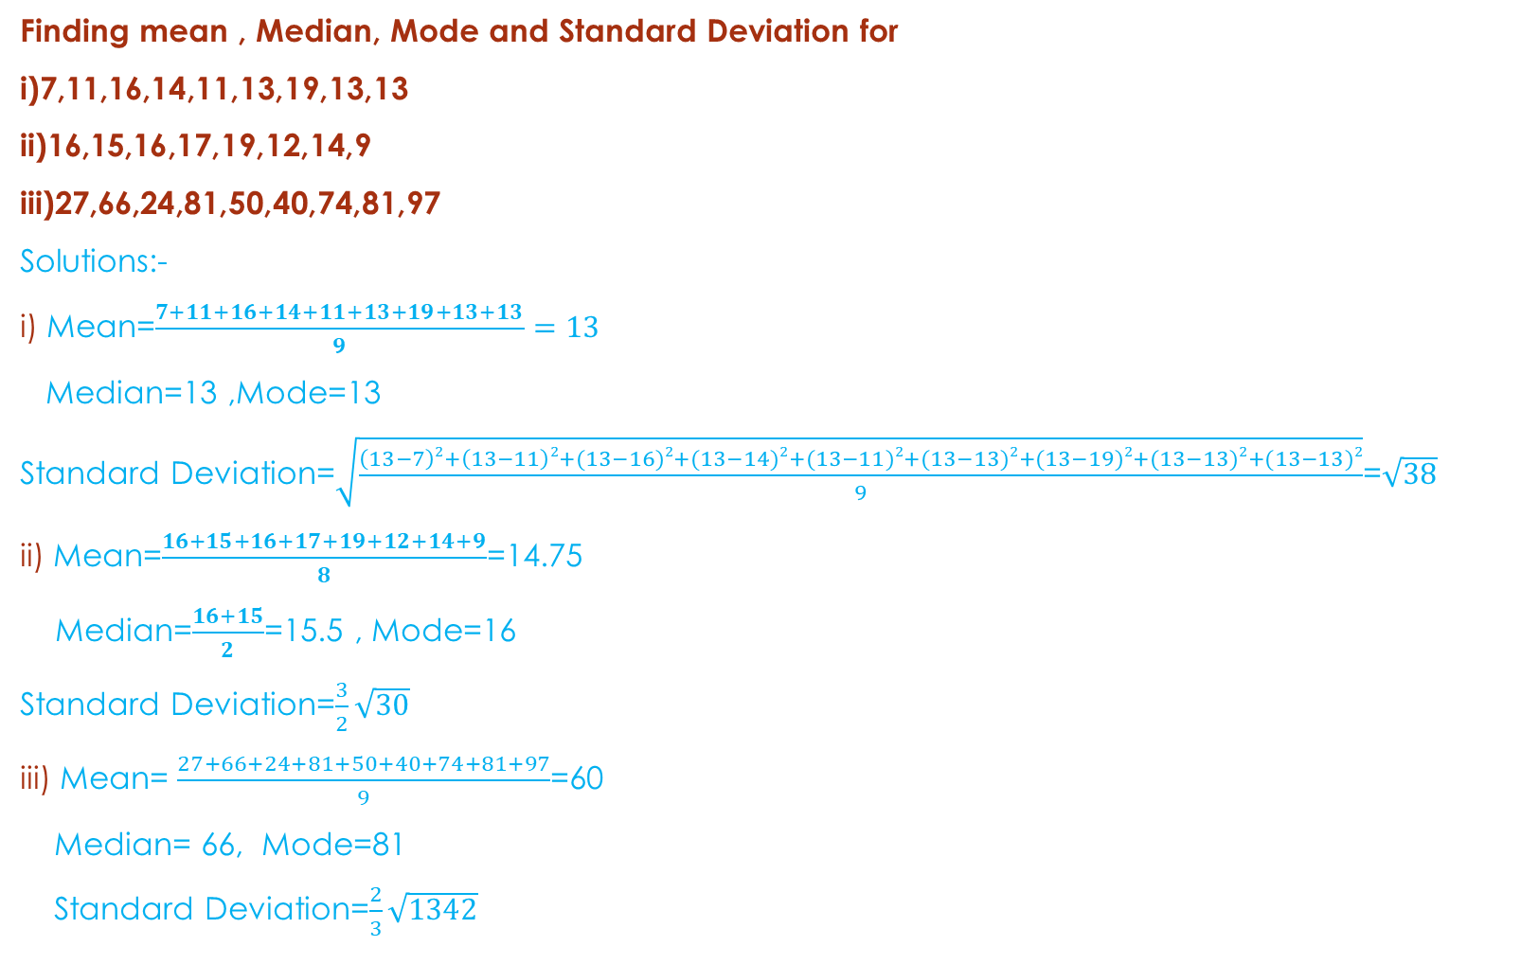
Finding mean , Median, Mode and Standard Deviation for
i)7,11,16,14,11,13,19,13,13
ii)16,15,16,17,19,12,14,9
iii)27,66,24,81,50,40,74,81,97
Solutions:-
i) Mean=$\frac{7+11+16+14+11+13+19+13+13}{9}=13$
Median=13 ,Mode=13
Standard Deviation=$\sqrt{\frac{\left(13−7\right)2+\left(13−11\right)2+(13−16)2+(13−14)2+(13−11)2+(13−13)2+(13−19)2+(13−13)2+(13−13)2}{9}}$=$\sqrt{38}$
ii) Mean=$\frac{16+15+16+17+19+12+14+9}{8}$=14.75
Median=$\frac{16+15}{2}$=15.5 , Mode=16
Standard Deviation=$\frac{3}{2}\sqrt{30}$
iii) Mean= $\frac{27+66+24+81+50+40+74+81+97}{9}$=60
Median= 66, Mode=81
Standard Deviation=$\frac{2}{3}\sqrt{1342}$

